Slide 1
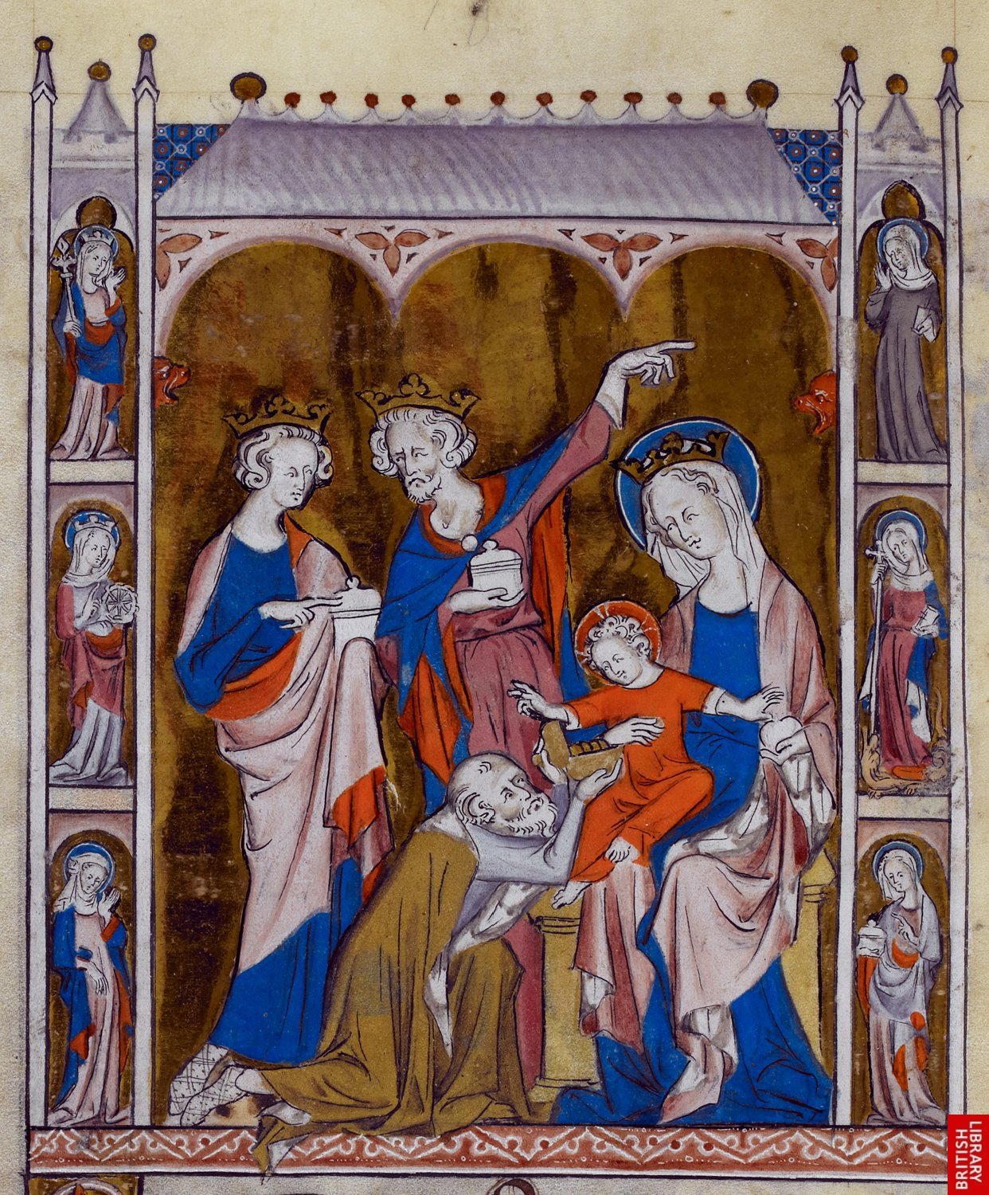
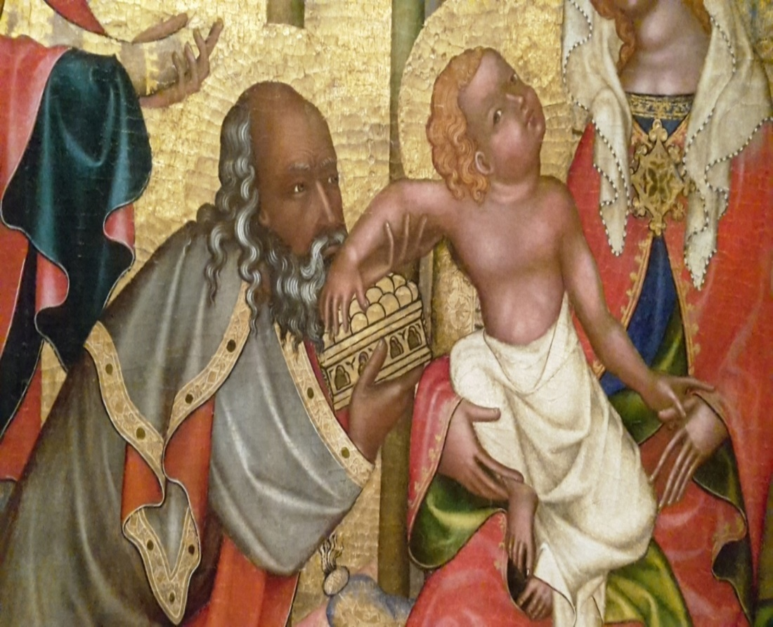
Višší Brod altarpiece, Prague, ca. 1350
Prague, National Museum
Queen Mary’s Psalter, 1310-1320
British Library - Royal 2 B VII f. 112v

Slide 2
Zacchaeus property
Countable
Calculable
Extensible
in its potentiality
also (re) countable
50%
lasts in his hands
by its Christian conversio
50%
to the Christian community:
in circulation, entering in a virtuous and fruitful circuit
the evangelical verset (Luke 19,8) and its Augustinian exegesis
to a Roman officer (Epistola 153)

Slide 3
each line
latitudo of commodity value
good 1 = 2,5÷4,5
good 2 = 1,9÷4,2
good 3 = 2÷5
the geometrical language adopted by Richard and then from Scotus - latitudo along which the aequitas could be achievable - cancels the arithmetical language based on the point (one figure) that represents the iustum pretium = x ± modica additio / deminutio

Slide 4
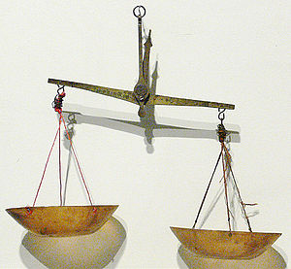
not one commodity in one market but two/more purchases in two/more markets
Marketplace 1/n
Commodity A
acquired at price higher than the fair price (justum pretium)
not resold in that market
Calculation of balance:
aequalitas
B
A
marketplace 1/n
marketplace2/n
Marketplace 2/n
Commodity B acquired here but not resold in this market
fair profit
from those operations, detracted the transport and risk expenditures

